Slide 1
C406 FINAL PROJECT – QUIZ GAME APP
BY TEAM 2 – Rhea Robinson, Sai Vaibhav Venkat, Bhavesh Pandey, Mayank Choudhary, Meenakshi Sharma, Rahul Prasad, Bhoomi Kaushik.

Slide 2

WELCOME TO QUIZENA THE BATTLE OF THE QUIZ LORDS

Slide 3
WHAT IS QUIZENA?
QUIZENA is an interactive and engaging quiz platform designed to challenge users with a variety of quizzes across multiple topics.
Designed with a gamified arena experience that keeps users motivated.
Built using modern web technologies for a seamless user experience.
Fosters a competitive environment by allowing users to compete for high scores and earn achievement badges.
The goal of Quizena is to make learning interactive, engaging, and rewarding, transforming the way people approach quizzes.

Slide 4
Features
01

Slide 5


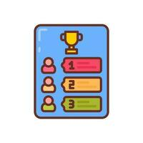

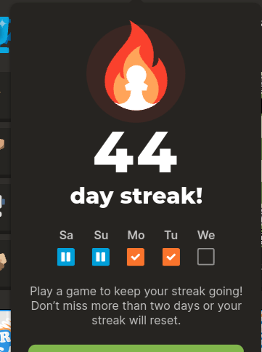
SINGLE PLAYER GAME
ONE ON ONE GAME
LEADERBOARD
SEND FRIEND REQUESTS AND PLAY WITH FRIENDS
DAILY LOGIN STREAKS

Slide 6
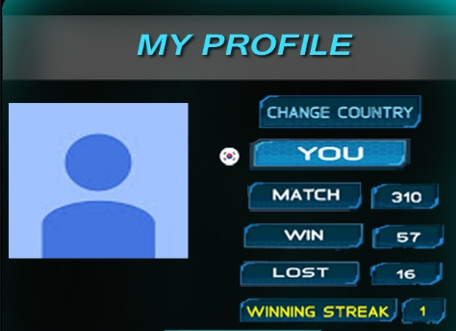

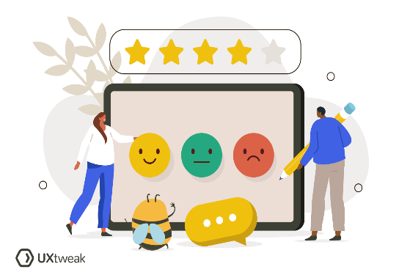


PLAYER PROFILE WITH STATISTICS
PLAY AND CREATE PUBLIC CHALLENGES
USER FEEDBACK
BADGE RANKING FOR TOP SCORERS
TIMED QUIZ CHALLENGES

Slide 7
02
Application Architecture

Slide 8
FRONTEND ARCHITECTURE
The frontend is developed using React.js with Vite for fast builds. Designed with a gamified arena experience that keeps users motivated.
It follows a component-based architecture for modularity and maintainability.
Integrated React State Management - React Hooks (useState, useEffect).
Uses React Router for navigation between pages.
Fetches data from the backend by making API calls with Token Authentication for protected routing

Slide 9
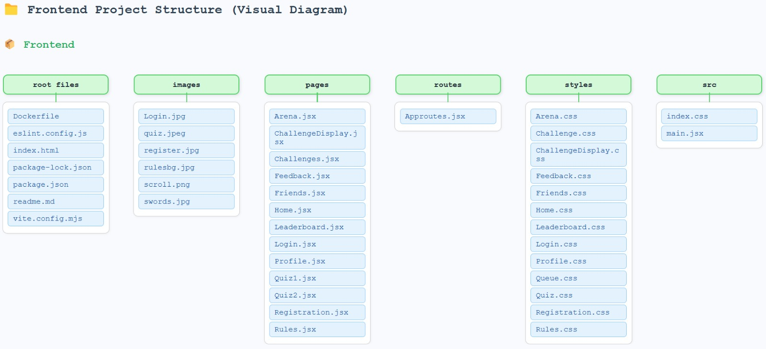

Slide 10
BACKEND ARCHITECTURE
Built using Node.js with Express.js for handling server-side logic and RESTful APIs.
Uses Supabase (PostgreSQL) as the database for scalable and efficient data management.
Implements Socket.IO for real-time, bi-directional communication between client and server.
Ensures secure authentication with jsonwebtoken, bcryptjs, and manages environment variables with dotenv.
Configured with CORS for secure cross-origin requests and UUID for unique resource identification.

Slide 11
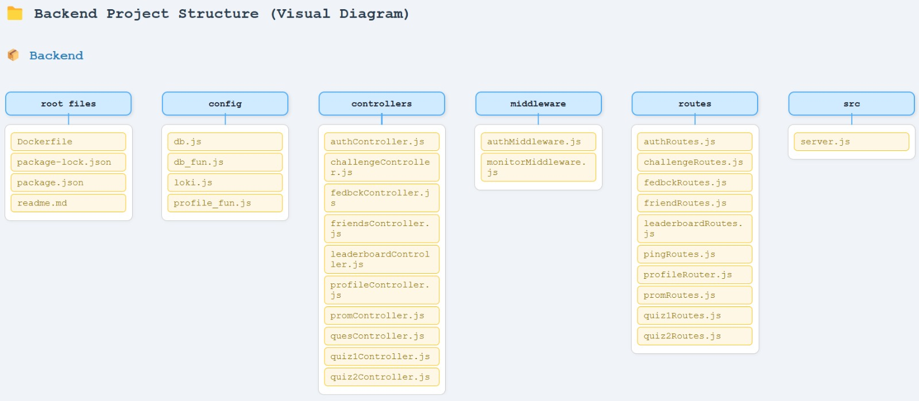

Slide 12
DATABASE INTEGRATION - SUPABASE
Supabase is an open-source backend platform that provides developers with powerful tools to build secure and scalable applications.
WHY SUPABASE?
Cloud-Hosted Infrastructure - Easily set up and manage your backend on the cloud without worrying about server management.
Built on PostgreSQL - Reliable, scalable, and ACID-compliant relational database.
Real-Time Capabilities - Automatically sync data across clients.
Serverless Edge Functions - Run backend logic close to your users without managing traditional servers.
Works seamlessly with modern frontend frameworks
Great for rapid prototyping and scaling into production

Slide 13
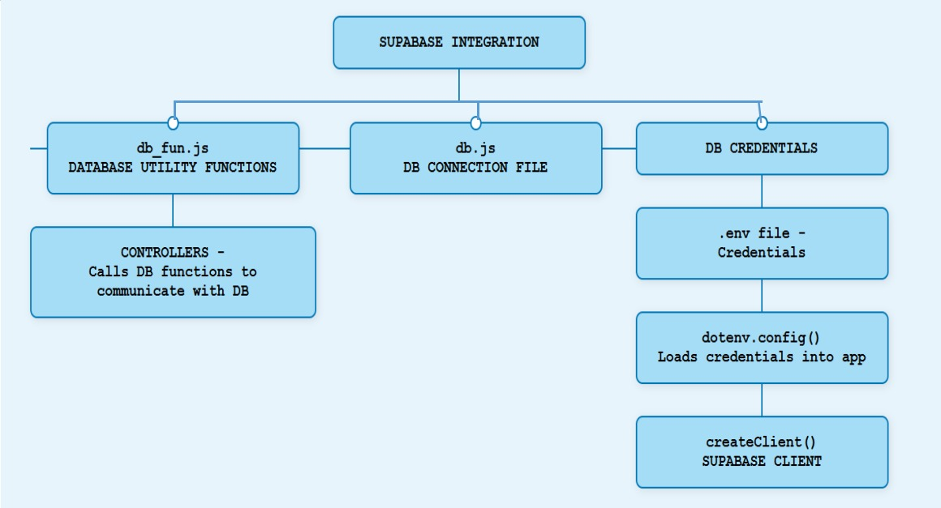
SUPABASE INTEGRATION

Slide 14
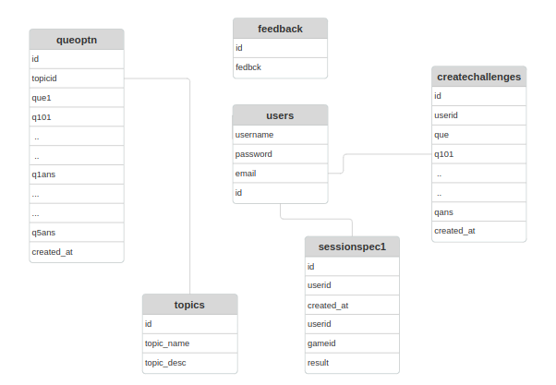
ER diagrams

Slide 15
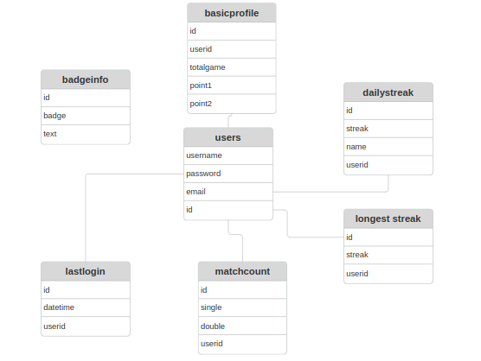
ER diagrams

Slide 16
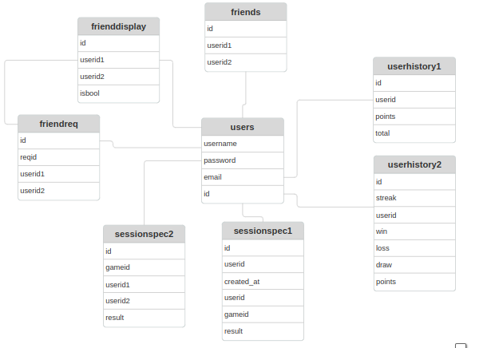
ER diagrams

Slide 17
03
SRE IMPLEMENTATION

Slide 18
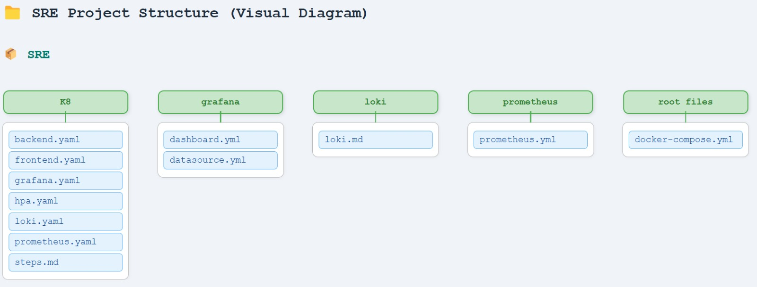
SRE IMPLEMENTATION

Slide 19
SRE IMPLEMENTATION - DOCKER
Through Dockerization we packaged our application with all its dependencies into a portable container, ensuring it runs consistently across any environment.
Application Containerization with Docker
Custom Dockerfiles for frontend (port 5174) and backend (port 5000)
Self-contained, portable application environments
Identical runtime behavior across all environments
Isolation of dependencies and configuration
Benefits
Consistent development and production environments
Simplified dependency management
Portable across any infrastructure
Efficient resource utilization

Slide 20
SRE IMPLEMENTATION – JENKINS
Using Jenkins we have automated the entire process of deploying the application.
Automation Process
Repository cloning from GitHub
Docker image building for frontend and backend
Docker Compose orchestration for testing
Minikube preparation and image loading
Kubernetes manifest application
Service exposure through port forwarding
Pipeline Stages
Clone Repository -> Build Docker Images -> Run Docker Compose -> Start Minikube -> Load Images into Minikube -> Deploy Kubernetes Manifests -> Port Forward Services

Slide 21
DOCKER COMPOSE
Local Development Environment
Single docker-compose.yaml orchestrates multiple services
Defines complete stack: backend, frontend, monitoring
Internal networking between services
Components of Docker Compose
Backend service container (API)
Prometheus container (metrics)
Loki container (logs)
Grafana container (visualization)

Slide 22
SRE IMPLEMENTATION - KUBERNETES
Integrated Kubernetes by including deployment files that automates deployment, scaling, and management of our containerized application.
Kubernetes Deployment Production Orchestration
Declarative YAML manifests for all components
Resource management with defined CPU limits
Configuration management with ConfigMaps
Service discovery via Kubernetes Services
Deployment Strategy
Images loaded directly from local Docker to Minikube
NodePort services for external access
Horizontal Pod Autoscaler for dynamic scaling (1-5 replicas)
Resource constraints ensure optimal cluster utilization

Slide 23
TOILS
Toils addressed and eliminated in this project:
Manual Environment Setup - Replaced by Docker containers for consistent, repeatable environments.
Manual Deployment of Services - Eliminated using manual Kubernetes deployment YAMLs for frontend and backend with Jenkins.
Manual Scaling - Replaced with Kubernetes Horizontal Pod Autoscaler (HPA) for automatic scaling based on load.
Manual Health Checks- Kubernetes probes and Prometheus alerting handle service health monitoring.
Manual Database Configuration- Supabase handles database provisioning, authentication, and API layer, reducing backend database toil.
Untracked Logs and Debugging- Centralized logging with Loki and metrics visualization in Grafana improves debugging and observability.
No Visibility into Performance- Prometheus + Grafana dashboards offer real-time system performance metrics.

Slide 24
TOILS
Redeploying Apps for Minor Updates- Kubernetes rolling updates and Docker allow smooth updates without downtime.
Manual Credential Handling- .env files (safely ignored in .gitignore) and Kubernetes secrets abstract away hardcoded secrets.

Slide 25
CHALLENGES FACED
Problems faced and how we fixed it– Player Matchmaking
Problem - No structured system for coordinated matchmaking. Players were not paired efficiently, leading to idle wait times. Game sessions weren’t uniquely identified, creating confusion in managing active sessions.
Solution - Implemented a queue-based matchmaking system.When 2 or more players are in the queue, the first two are dequeued and matched.A unique session ID is generated for each game using UUID, ensuring each session is isolated and trackable.
Outcome - Smooth and efficient player pairing. Unique identification of every session helped with traceability and session management. Improved user experience with faster game starts and better backend coordination.

Slide 26
CHALLENGES FACED
Problem – Docker compose version
Jenkins pipeline failed to run Docker Compose commands.
The error occurred due to incompatibility with Docker Compose v1 syntax, which was deprecated.
Jenkins agents expected Docker Compose v2, but the project was still using version 1 format in docker compose yaml file.
Solution
Updated the project’s Docker setup to Docker Compose v2 syntax.
Adjusted Jenkins pipeline to use the correct Compose plugin version.
Outcome
Jenkins pipelines ran successfully with no build/deploy interruptions.Ensured future compatibility with modern Docker standards.Reduced build-time errors and boosted CI/CD reliability.

Slide 27
CHALLENGES FACED
Problems – Real time communication with players
Problem - The backend lacked a real-time communication mechanism to manage player states and interactions.
Traditional HTTP-based communication wasn’t efficient for features like
Live matchmaking updates
In-game actions and notifications
Session synchronization
Solution - Integrated Socket.IO to establish a bidirectional, event-driven communication channel.
Enabled features like:
Real-time player connection/disconnection handling
Live session tracking and updates
Immediate response to user actions (e.g., game moves, matchmaking status)
Outcome - Smooth and efficient player pairing. Unique identification of every session helped with traceability and session management.

Slide 28
FUTURE SCOPE
Role-Based Access Control (RBAC) - Add fine-grained RBAC policies across services and Kubernetes clusters to enhance security and team collaboration.
Multi-Cloud & Backup Strategy -Extend deployment support to multi-cloud environments (e.g., AWS, GCP). Integrate scheduled data backup and recovery pipelines using Supabase's APIs.
Advanced Monitoring & Alerts - Use Grafana Alerts, Prometheus Rules, and Alertmanager for proactive incident detection and notification.
AI/ML-driven Matchmaking - Leverage user behavior data to build intelligent matchmaking models that enhance user experience and fairness.

Slide 29
Conclusions
Our Quiz Game App successfully integrates gamification features to enhance user engagement. Through personalized scoring, competitive elements like leaderboards and badges, and a user-centric interface, we have developed a platform that not only meets but exceeds user expectations for interactive quiz experiences.

Slide 30
THANK YOU

